Slide 1
Deep Learning Unit 1 Fundamentals of Deep Learning

Slide 2
AI Vs ML Vs DL
AI | ML | DL
1956 John McCarthy Machine to Mimic Human Behavior. | 1959 Arthur Samuel Machine to Learn. Training Time Less Testing Time More | 2000 Igor Aizenberg Algo. Inspired by Structure & Functions of Human Brain. Training Time More Testing Time Less

Slide 3
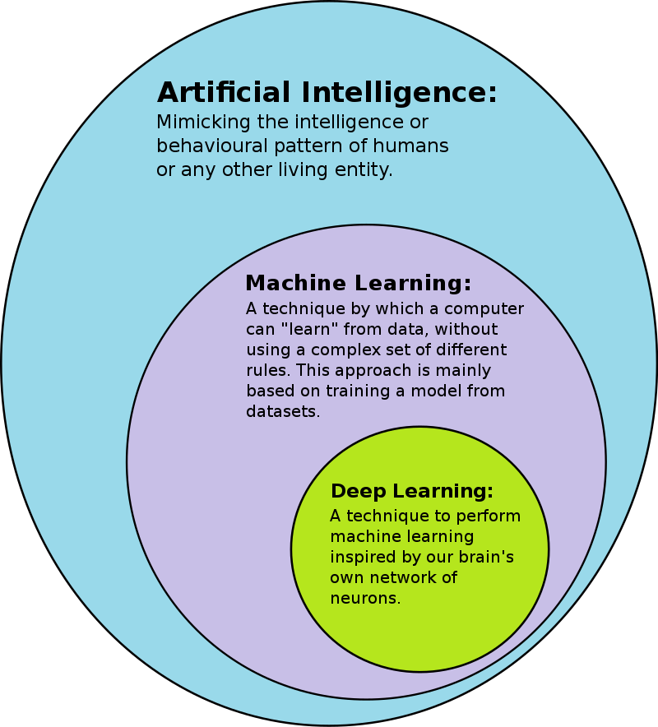

Slide 4
What is Deep Learning ?
A type of machine learning based on artificial neural networks in which multiple layers of processing are used to extract progressively higher level features from data.
Deep learning is part of a broader family of machine learning methods based on artificial neural networks with representation learning.

Slide 5
Deep Learning
Why ? | What ? | Where ?
Huge Amount of Data. | Handle huge amount of Structured and Unstructured data. | Medical field
Complex problems | Complex Operations, Problems Solved | Self driving Cars
Feature Extraction |  | Translation

Slide 6
Multilayer Perceptron
Perceptron
Learn Machine Learning and Deep Learning technologies.
Consists of : a set of weights, input values or scores, and a threshold.
Perceptron is a building block of an Artificial Neural Network.
Mid of 19th century, Mr. Frank Rosenblatt invented the Perceptron.
Perceptron perform certain calculations to detect input data capabilities or business intelligence.

Slide 7
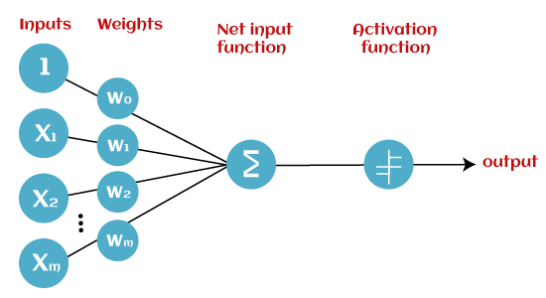
Perceptron - a linear Machine Learning algorithm used for supervised learning for various binary classifiers.
Algorithm enables neurons to learn elements and processes them one by one during preparation.
Basic Components of Perceptron:

Slide 8
Input Nodes or Input Layer:
Primary component of Perceptron, contains a real numerical value.
Wight and Bias:
Weight - represents the strength of the connection between units.
Weight is directly proportional to the strength of the associated input neuron in deciding the output.
Biases - scalar values added to the input to ensure that at least a few nodes per layer are activated regardless of signal strength.

Slide 9
Activation Functions:
Functions that govern the artificial neuron’s behavior are called activation functions.
Transmission of that input is known as forward propagation.
Activation functions transform the combination of inputs, weights and biases.
Artificial neuron passes on a nonzero value to another artificial neuron, said to be activated.

Slide 10
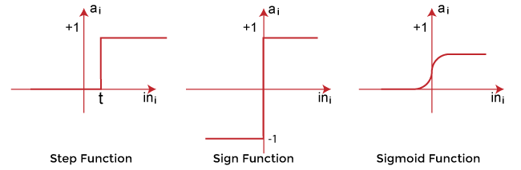
Types of Activation functions:
Sign function.
Step function.
Sigmoid function.

Slide 11
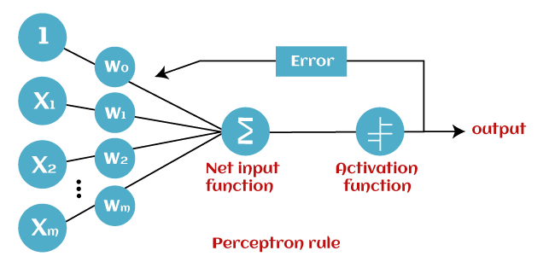
MLP Algorithm

Slide 12
1. Begins with the multiplication of all input values and their weights.
2. Adds all values together to create the weighted sum.
3. Weighted sum is applied to the activation function ‘g' to obtain the desired output.
Activation function also known as the step function and is represented by ‘g'.
Perceptron model works in two important steps.

Slide 13
Step-1
First step: Weighted sum.
∑wi*xi = x1*w1 + x2*w2 +…wn*xn
Add bias 'b’,improve the model's performance.
∑wi*xi + b
Step-2
Activation function is applied ,output either in binary form or a continuous value.
Y = f(∑wi*xi + b)

Slide 14
MLP model has a greater number of hidden layers.
MLP model also known as the Backpropagation algorithm.
Two Execution Stages :
Forward Stage:
Activation functions start from the input layer in the forward stage and terminate on the output layer.
Backward Stage:
Weight and bias values are modified as per the model's requirement.

Slide 15
Advantages of Multi-Layer Perceptron:
Can be used to solve complex non-linear problems.
Works well with both small and large input data.
Helps to obtain quick predictions after the training.
Helps to obtain the same accuracy ratio with large as well as small data.
Disadvantages of Multi-Layer Perceptron:
Computations are difficult and time-consuming.
Difficult to predict how much the dependent variable affects each independent variable.
Model functioning depends on the quality of the training.

Slide 16
Feed-Forward Neural Network
FFN Neural Network is an artificial neural network in which the connections between nodes does not form a cycle.
Information is only processed in one direction.
Data may pass through multiple hidden nodes, it always moves in one direction and never backwards.
A single input layer.
One or many hidden layers, fully connected
A single output layer.

Slide 17
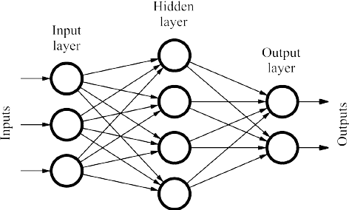

Slide 18
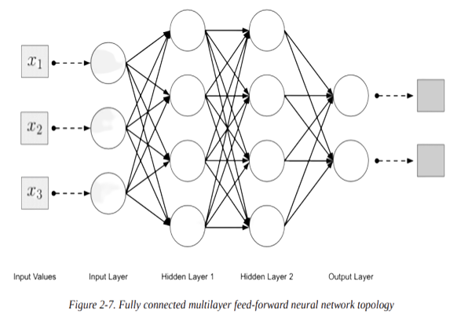

Slide 19
Input layer:
Number of neurons in an input layer is typically the same number as the input feature to the network.
Input layers are followed by one or more hidden layers.
Input layers in classical feed-forward neural networks are fully connected to the next hidden layer.
Hidden layer:
One or more hidden layers in a feed-forward neural network.

Slide 20
Weight values on the connections between the layers are how neural networks encode the learned information extracted from the raw training data.
Hidden layers are the key to allowing neural networks to model nonlinear functions.
Output layer:
Answer or prediction from our model from the output layer.
Depending on the setup of the neural network, the final output may be a real-valued output (regression) or a set of probabilities (classification).

Slide 21
Controlled by the activation function.
Typically uses either a softmax or sigmoid activation function for classification.
Connections between layers :
Previous layer to all next layer.
Weights change progressively as algorithm finds the best solution.

Slide 22
Backpropagation Learning
Backpropagation is an important part of reducing error in a neural network model.
Backpropagation, how information circulates within a feed-foward neural network.
Algorithm intuition :
Backpropagation learning is similar to the perceptron learning algorithm.
Compute the input example’s output with a forward pass through the network.
If the output matches the label, we don’t do anything.
If the output does not match the label, we need to adjust the weights on the connections in the neural network.

Slide 23
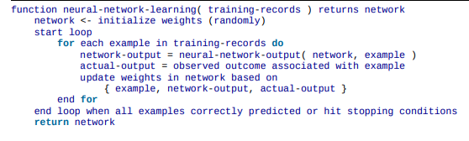
General neural network training pseudo code :

Slide 24
With the perceptron learning algorithm, it’s easy because there is only one weight per input to influence the output value.
With feed forward multilayer networks learning algorithms, many weights connecting each input to the output, so it becomes more difficult.
Each weight contributes to more than one output.
With backpropagation,minimize the error between the label (or “actual”) output associated with the training input and the value generated from the network output.

Slide 25
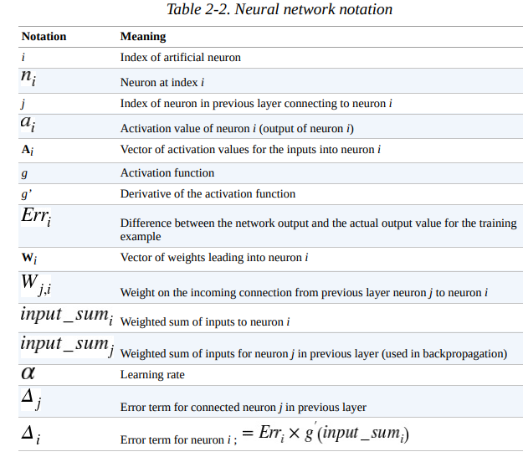

Slide 26

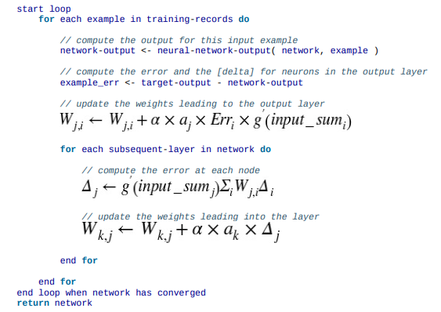
Backpropagation algorithm for updating weights pseudo code

Slide 27
Gradient Descent (Steepest Descent)

Slide 28
Gradient Descent
Discovered by "Augustin-Louis Cauchy" in mid of 18th century.
Gradient Descent is defined as one of the most commonly used iterative optimization algorithms of machine learning to train the machine learning and deep learning models.
It helps in finding the local minimum of a function.
Cost-function Vs Loss Function :
The loss function calculates the error per observation, whilst the cost function calculates the error over the whole dataset.

Slide 29
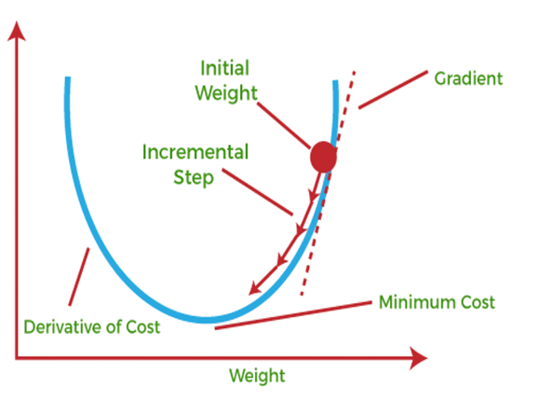

Slide 30
In GD, we can imagine the quality of our network’s predictions
Hills represent locations (parameter values or weights) that give a lot of prediction error; valleys represent locations with less error.
Choose one point on that landscape at which to place our initial weight.
Select the initial weight randomly.
Move weight downhill, to areas of lower error.
GD can sense the actual slope of the hills with regard to each weight, direction is down.

Slide 31
GD measures the slope and takes the weight one step toward the bottom of the valley.
Taking a derivative of the loss function to produce the gradient.
In convex optimization, looking for the point at which the derivative is equal to 0.
Point is known as stationary point of the function or the minimum point.
Process of measuring loss and changing the weight by one step in the direction of less error is repeated until the weight arrives at a point beyond which it cannot go lower.

Slide 32
Learning Rate:
Defined as the step size taken to reach the minimum or lowest point.
Typically a small value that is evaluated and updated based on the behavior of the cost function.
Learning rate is high :
Results: Larger steps but leads to risks of overshooting the minimum.
Learning rate is low :
Result : Small step sizes, advantage of more precision.

Slide 33
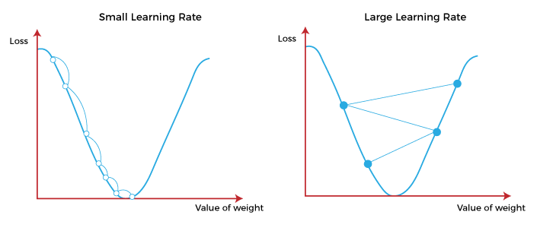

Slide 34
Gradient Descent Procedure
Suppose we have a function f(x), where x is a tuple of several variables., x = (x_1, x_2, …x_n).
Suppose gradient of f(x) is given by ∇f(x).
We want to find the value of the variables (x_1, x_2, …x_n) that give us the minimum of the function.
At any iteration t, we’ll denote the value of the tuple x by x[t].
So x[t][1] is the value of x_1 at iteration t, x[t][2] is the value of x_2 at iteration t, e.t.c.

Slide 35
Notation
t = Iteration number
T = Total iterations
n = Total variables in the domain of f (also called the dimensionality of x)
j = Iterator for variable number, e.g., x_j represents the jth variable
𝜂 = Learning rate
∇f(x[t]) = Value of the gradient vector of f at iteration t

Slide 36
Training Method
Choose a random initial point x_initial and set x[0] = x_initial
For iterations t=1..T
Update x[t] = x[t-1] – 𝜂∇f(x[t-1])
The learning rate 𝜂 is a user defined.
Its value lies in the range [0,1].

Slide 37
Two iterations of the algorithm, T=2 and 𝜂=0.1
Initial t=0
x[0] = (4,3) # This is just a randomly chosen point
At t = 1
x[1] = x[0] – 𝜂∇f(x[0])
x[1] = (4,3) – 0.1*(8,12)
x[1] = (3.2,1.8)
At t=2
x[2] = x[1] – 𝜂∇f(x[1])
x[2] = (3.2,1.8) – 0.1*(6.4,7.2)
x[2] = (2.56,1.08)
Procedure will eventually end up at the point where the function is minimum, i.e., (0,0).

Slide 38
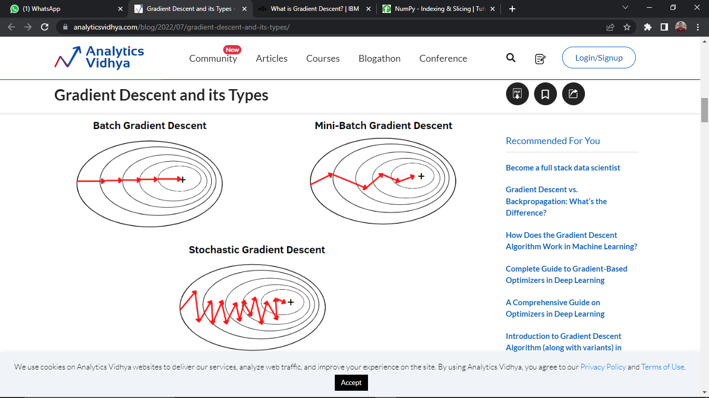
Types of Gradient Descent
Batch Gradient Descent.
Stochastic Gradient Descent.
Mini-Batch Gradient Descent.

Slide 39
Batch Gradient Descent
Also known as vanilla gradient descent.
Calculates the error for each example within the training dataset.
Still, the model is not changed until every training sample has been assessed.
Entire procedure is referred to as a cycle and a training epoch.
Advantages of Batch gradient descent:
Produces less noise in comparison to other gradient descent.
Produces stable gradient descent convergence.
Computationally efficient as all resources are used for all training samples.

Slide 40
Stochastic gradient descent
Stochastic gradient descent (SGD) is a type of gradient descent that runs one training example per iteration.
As it requires only one training example at a time, hence it is easier to store in allocated memory.
Frequent updates, it is also treated as a noisy gradient.
Advantages :
It is easier to allocate in desired memory.
It is relatively fast to compute than batch gradient descent.
It is more efficient for large datasets.

Slide 41
MiniBatch Gradient Descent:
Combination of both batch gradient descent and stochastic gradient descent.
Divides the training datasets into small batch sizes.
Performs the updates on those batches separately.
We can achieve a special type of gradient descent with higher computational efficiency and less noisy gradient descent.
Advantages :
It is easier to fit in allocated memory.
It is computationally efficient.
It produces stable gradient descent convergence.

Slide 42
VANISHING GRADIENT PROBLEM
A phenomenon that occurs during the training of deep neural networks, where the gradients that are used to update the network become extremely small or "vanish“.
As they are backpropogated from the output layers to the earlier layers.
Backpropogation algorithm calculates gradients by propagating the error from the output layer to the input layer.
Gradient problem include slow convergence, network getting stuck in low minima, and impaired learning of deep representations.

Slide 43
How do you overcome the vanishing gradient problem?
Skip connections
Provides direct connections between layers.
Allowing the gradients to bypass multiple layers during backpropogation.
Residual neural networks (ResNets)
ResNets use skip connections to learn the residual mapping,
Enabling easier gradient flow & efficient training of deep neural networks.

Slide 44
Rectified linear unit (ReLU)
ReLU avoids the saturation function sigmoid tangent or hyperbolic tangent, that can cause the gradients to vanish.
Long Short Term Memory
Type of artificial neural network which uses sequential data or time series data.
Vanishing Gradient Problem occurs when the gradients become too large or too small .

Slide 45
Optimization Algorithms

Slide 46
Optimization Algorithms :
Training a model in machine learning involves finding the best set of values for the parameter vector of the model.
Optimization problem in which minimize the loss function with respect to the parameters of prediction function.
Define best set of values for the parameter vector as the values with lowest loss function.
Divide the Algorithms :
First – order.
Second – order.

Slide 47
First-order optimization algorithms calculate the Jacobian matrix.
Jacobian is a matrix of partial derivatives of loss function values with respect to each parameter.
To calculate partial derivatives, all other variables are momentarily treated as constants.
Algorithm takes one step in the direction specified by the Jacobian.

Slide 48
First-order methods
Taking one step at a time to reach an objective, first-order methods calculate a gradient (Jacobian) at each step to determine which direction to go in next.
Each iteration, or step, we are trying to find the next best possible direction to go, as defined by objective function.
Consider optimization algorithms to be a "search."
Finding a path toward minimal error.
Gradient descent is a member of path-finding class of algorithms.

Slide 49
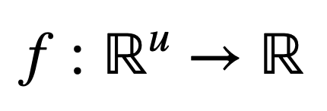
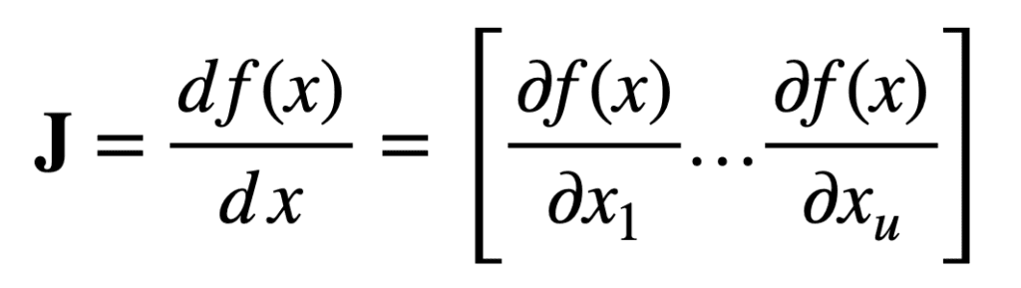
The Jacobian Matrix
Consider first a function that maps u real inputs, to a single real output.
For an input vector, x, of length, u, the Jacobian vector of size, 1 × u, can be defined as

Slide 50
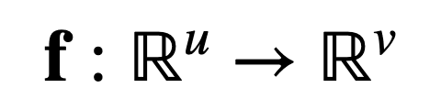
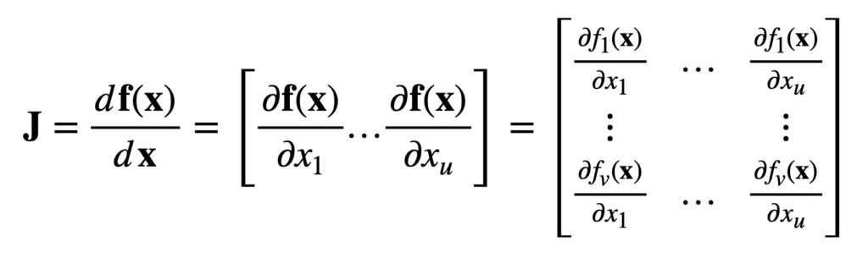
Consider another function that maps u real inputs, to v real outputs:
For the same input vector, x, of length, u, the Jacobian is now a v × u matrix.

Slide 51
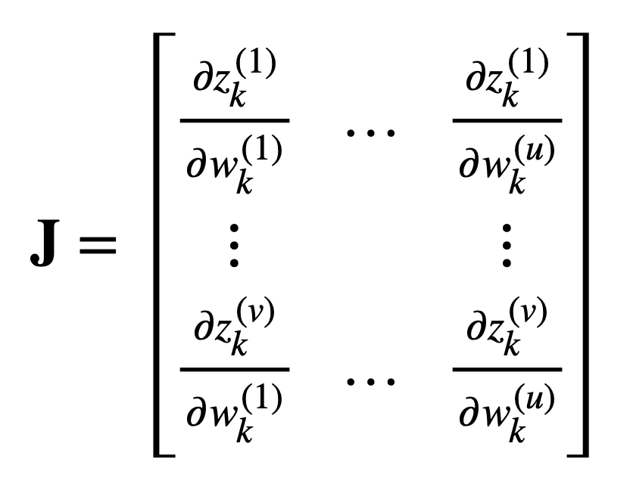
u real inputs and v real outputs, matrix .

Slide 52
Second-order algorithms calculate the derivative of the Jacobian (i.e., the derivative of a matrix of derivatives) by approximating the Hessian.
Second order methods take into account interdependencies between parameters when choosing how much to modify each parameter.
Second-order methods can take "better" steps; however, each step will take longer to calculate.

Slide 53

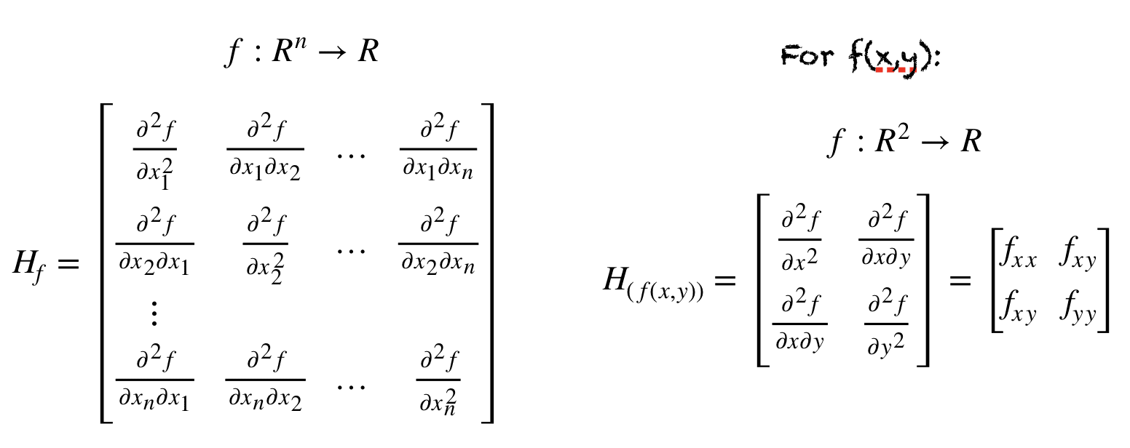
Hessian Matrix
We have a function f of n variables
Hessian of f is given

Slide 54
Second-order methods
Hessian Matrix of second-order partial derivatives, analogous to "tracking acceleration rather than speed."
The Hessian's job is to describe the curvature of each point of the Jacobian.
Second-order methods include:
Limited-memory BFGS (L-BFGS).
Conjugate gradient
Hessian-free

Slide 55
L-BFGS is an optimization algorithm and a so-called quasi-Newton method.
It's a variation of the Broyden-Fletcher-Goldfarb-Shanno (BFGS) algorithm, and it limits how much gradient is stored in memory.
Algorithm does not compute the full Hessian matrix, which is more computationally expensive.
Hessian L-BFGS stores only a few vectors that represent a local approximation of it.
L-BFGS performs faster because it uses approximated second-order information.
L-BFGS and conjugate gradient in practice can be faster and more stable than SGD methods.

Slide 56
Conjugate gradient guides the direction of the line search process based on conjugacy information.
Conjugate gradient methods focus on minimizing the conjugate L2 norm.
L2-norm is also known as least squares. It is basically minimizing the sum of the square of the differences between the target value and the estimated values.
Conjugate gradient is very similar to gradient descent in that it performs line search.
The major difference is that conjugate gradient requires each successive step in the line search process.

Slide 57
Hessian-free
Hessian-free optimization is related to Newton's method, but it better minimizes the quadratic function.
It is a powerful optimization method adapted to neural networks by James Martens in 2010.
We find the minimum of the quadratic function with an iterative method called conjugate gradient.

Slide 58
Hyper Parameters

Slide 59
Hyper Parameters
Hyperparameters are the variables which determines the network structure.
Eg: Number of Hidden Layers.
& the variables which determine how the network is trained.
Eg: Learning Rate.
Hyperparameters are set before training (before optimizing the weights and bias).

Slide 60
Hyper parameters
Layer size.
Magnitude (momentum, learning rate).
Regularization (dropout, drop connect, L1, L2)
Activations (activation function families)
Weight initialization strategy.
Loss functions
Settings for epochs during training (mini-batch size)
Normalization scheme for input data (Vectorization).

Slide 61
Layer Size
Layer size : Number of neurons in a layer.
Input and output layers are easy to figure out.
Deciding neuron counts for hidden layer is a challenge.
Neurons come with a cost.
Connection schema between layers can vary.
Weights on the connections, are the parameters we must train.
More parameters -increase the amount of effort needed to train the network.
Long training times - models struggle to find convergence.

Slide 62
Magnitude – Hyper parameter
Magnitude group involve gradient, step size, and momentum.
Learning rate defines how quickly a network updates its parameters.
Low learning rate slows down the learning process but converges smoothly.
Larger learning rate speeds up the learning but may not converge.
Momentum helps to know the direction of the next step with the knowledge of the previous steps.
Speed up our training by increasing momentum.

Slide 63
Momentum is a factor between 0.0 and 1.0 ,applied to the change rate of the weights.
Typically, the value for momentum between 0.9 and 0.99.
Adaptive Gradient Algorithm (Adagrad) is an algorithm for gradient-based optimization.
AdaGrad - Technique to help finding the “right” learning rate.
AdaGrad is monotonically decreasing and never increases the learning rate.
AdaGrad is the square root of the sum of squares of the history of gradient computations.

Slide 64
AdaGrad speeds training in the beginning and slows it appropriately toward convergence.
RMSprop (Root Mean Square Propagation) is a very effective, but currently unpublished adaptive learning rate method.
AdaDelta is a variant of AdaGrad that keeps only the most recent history.
Adam (adaptive moment estimation).
Derives learning rates from estimates of first and second moments of the gradients.
First Moment : sum of gradient.
Second Moment : sum of the gradient squared.

Slide 65
Regularization
Regularization is a measure taken against overfitting.
Overfitting : when a model describes the training set but cannot generalize well over new inputs.
Overfitted models have no predictive capacity for data that they haven’t seen.
Geoffery Hinton described the best way to build a neural network model:
Cause it to overfit, and then regularize it to death.

Slide 66
Regularization, modify the gradient so that it doesn’t step in directions that lead it to overfit.
Regularization includes :
Dropout
Drop Connect
L1 penalty
L2 penalty

Slide 67
Dropout :
Dropout is driven by randomly dropping a neuron so that it will not contribute to the forward pass and back propagation.
Dropout is a mechanism used to improve the training of neural networks by omitting a hidden unit.
It also speeds training.
DropConnect :
DropConnect does the same thing as Dropout, but instead of choosing a hidden unit, it mutes the connection between two neurons.

Slide 68
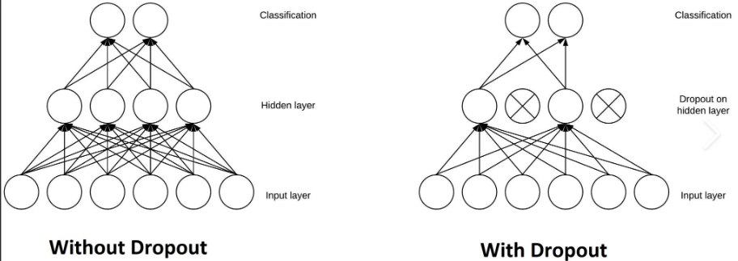
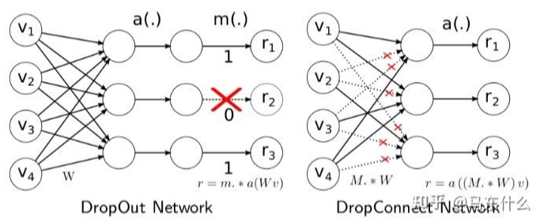

Slide 69
Penalty Methods :
Regularization :
Regularization is a way to avoid overfitting by penalizing high-valued regression coefficients.
Regression coefficients are used to predict the value of an unknown variable using a known variable.
It reduces parameters and shrinks (simplifies) the model.
Regularization adds penalties to more complex.
Model with the lowest “overfitting” score is usually the best choice for predictive power.

Slide 70
Regularization works by biasing data towards particular values (such as small values near zero).
L1 regularization adds an L1 penalty equal to the absolute value of the magnitude of coefficients.
In other words, it limits the size of the coefficients.
L1 can yield sparse models (i.e. models with few coefficients);
Some coefficients can become zero and eliminated.
Lasso regression uses this method.

Slide 71
L2 regularization adds an L2 penalty equal to the square of the magnitude of coefficients.
L2 will not yield sparse models and all coefficients are shrunk by the same factor (none are eliminated).
Ridge regression and SVMs use this method.
Elastic nets combine L1 & L2 methods, but do add a hyperparameter

Slide 72
Mini-batching
Batch size always seems to affect training.
Using a very small batch size can lead to slower convergence of the model.
Too small or a too large batch size can both affect training badly.
A batch size of 32 or 64 almost always seems like a good option.

